Slide 1
CQR Technical Committee Meeting
IEEE ICC 2017
CQR Chair: Scott Poretsky
Acting, CQR Chair Elect. Tetsuya Yokotani
May 23, 2017
Paris, France

Slide 2
Agenda
WELCOME
CQR Background and Activities
CQR Workshop 2017
CQR Workshop 2018
ADJOURN

Slide 3
ComSoc 25 Technical Committees and 15 Emerging Technical Subcommittees
Ad Hoc & Sensor Networks
Cognitive Networks
Communications & Information Security
Communications Quality and Reliability
Communications Software
Communications Switching & Routing
Communications Systems Integration & Modeling
Communication Theory
Computer Communications
Data Storage
e-Health
Green Communications & Computing
Information Infrastructure & Networking
Innovation & Standards in Information & Communication Technologies(ISICT)
Internet
Multimedia Communications
Network Operations & Management
Optical Networking
Power Line Communications
Radio Communications
Satellite & Space Communications
Signal Processing & Communications Electronics
Social Networks
Transmission, Access, & Optical Systems
Wireless Communications
Subcommittees: 5G Mobile Wireless Internet, Big Data, Internet of Things, etc.

Slide 4
CQR Background and Activities
CQR: Technical Committee on
Communications Quality & Reliability
Established in 1986 as QAMC (Quality Assurance Management Committee)
Hold annual CQR International Workshop for industry and academia
Coordinate and lead CQRM Symposia twice per year at ICC and GlobeComm
Lead Emerging Technologies Roundtable for SDN/NFV Quality and Reliability
Three Committee Meetings each year:
CQR Workshop 2017, May, Naples, FL
ICC 2017, May, Paris France
GLOBECOM 2017, Dec, Singapore
Meeting presentations and minutes are posted on the CQR Technical Committee web site

Slide 5
Major Accomplishment
The CQR Workshops and Emerging Technologies Roundtables led academic-industry collaboration along with the IEEE Security, Reliability, and Performance for Software Defined and Virtualized Ecosystems (SRPSDVE) Study Group.
This led to creation of 3 new IEEE Working Groups on Security, Performance and Reliability including IEEE 1917.1 WG on SDN/NFV Reliability.

Slide 6
CQR Charter
Revised Nov. 2009
Focuses on and advocates worldwide communications and reliability on behalf of, and within, the Communications Society.
Serves as the catalyst for global awareness and the exchange of information relative to technical and management-related aspects of communications quality and reliability. This also extends to security of the telecommunications network.
CQR technical subject matter includes:
I. Service Quality and Reliability
II. Network Quality and Reliability
III. Product and System Quality and Reliability

Slide 7
IEEE Certification
Recertification every 5 years
Last completed in 2012
Currently completing process for 2017

Slide 8
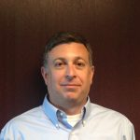
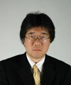
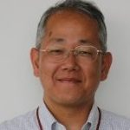
2016-17 Officers
2 year terms
Election Nov 2017 for 2018-2019 term
• Chair Scott Poretsky, Allot Communications, USA
• Chair-Elect Tetsuya Yokotani, Kanazawa Institute of Technology, Japan
• Vice Chair – Social Media Chris Mayer, Solstice technical Consulting, USA
• Vice Chair - Operations Kohei Shiomoto, Tokyo City Univ. , Japan
Notes:
.

Slide 9
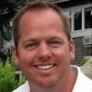
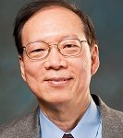
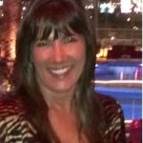
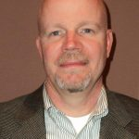
2016-17 Officers (Cont.)
Vice Chair – Program Development Michael Ryan, Verizon, USA
• Vice Chair - Publications Weider Yu, SJSU, USA
• Secretary Tara Timblin, Comtech Telecommunications, USA
• Treasurer Kevin Krantz, Ericsson, USA

Slide 10
CQR Advisory Board Members
Chair
Hideaki Yoshino, Nippon Institute of Technology, JP
Honorable Member
Kelly Krick, (Chair), Ericsson, US
• Hiromi Ueda, Tokyo Univ. of Tech., JP
• Chi-Ming Chen, AT&T, US
• Kenichi Mase, Niigata Univ., JP
• Karl Rauscher, EastWest Institute, US
• Koichi Asatani, Nankai Univ.,CN
• Raymond Bonelli, Consultant, US

Slide 11
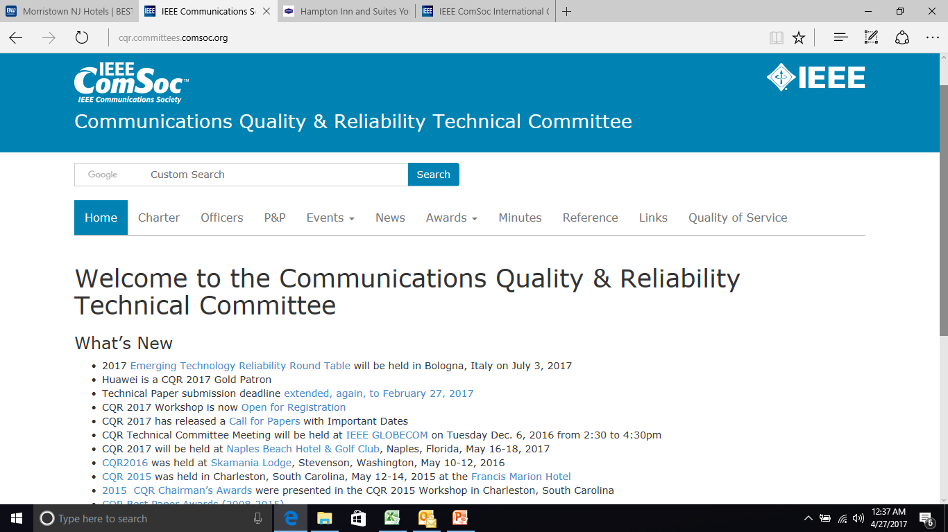
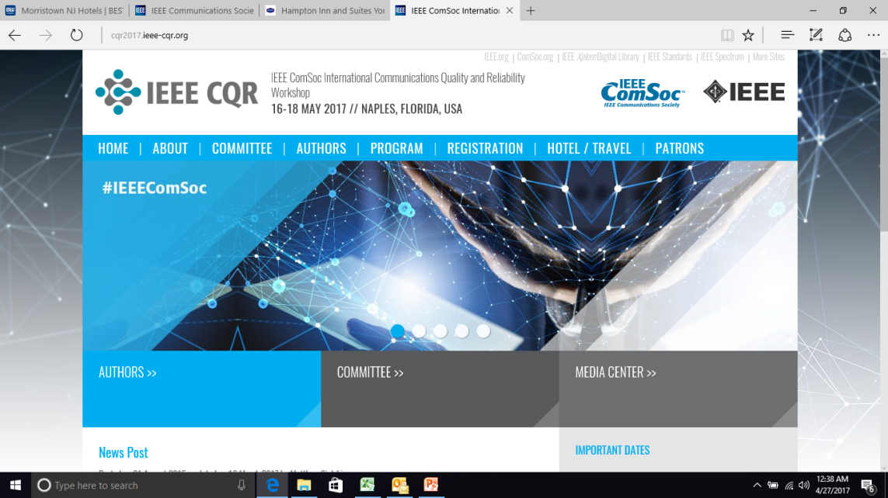
CQR Websites and Social Media
Led by Vice-Chair Social Media,
Chris Mayer
Twitter Handle:
@ieeecqr
http://cqr.committees.comsoc.org/ and http://cqr2017.ieee-cqr.org/

Slide 12
IEEE : CQRM Symposia
Year | ICC | GLOBECOM
2002 | 4/28-5/2, New York Koichi Asatani | 11/17-21, Taipei, Taiwan Koichi Asatani
2003 | 5/11-15, Anchorage Koichi Asatani | 12/01-05, San Francisco -
2004 | 6/20-24, Paris, France Koichi Asatani | 11/29-12/3, Dallas -
2005 | 5/16-20, Seoul, Korea Hiromi Ueda | 11/28 – 12/2, St. Louis -
2006 | 6/11-15, Istanbul, Turkey Hiromi Ueda | 11/27 – 12/1, San Francisco Hiromi Ueda
2007 | 6/24-28, Glasgow, UK Hiromi Ueda | 11/26 – 11/30, Washington, DC -
2008 | 5/19-23, Beijing, China Hiromi Ueda | 11/30 – 12/4, New Orleans Toshinori Tsuboi
2009 | 6/14-18, Dresden, Germany Hiromi Ueda | 11/30 – 12/4, Honolulu Hajime Nakamura

Slide 13
IEEE : CQRM Symposia (Cont.)
Year | ICC | GLOBECOM
2010 | 5/23-27, Cape Town, South Africa Toshinori Tsuboi | 12/06-10, Miami Hideaki Yoshino
2011 | 6/05-09, Kyoto, Japan Toshinori Tsuboi | 12/05-09, Houston Tetsuya Yokotani
2012 | 6/10-15, Ottawa, Canada Hideaki Yoshino | 12/03-07, Anaheim Tetsuya Yokotani
2013 | 6/09-13, Budapest, Hugary Tetsuya Yokotani | 12/09-13, Atlanta Hideaki Yoshino
2014 | 6/10-14, Sydney, Australia Kohei Shiomoto | 12/8-12, Austin Weider Yu
2015 | 6/8-12, London, UK Kelly Krick | 12/6-10, San Diego Kohei Shiomoto
2016 | 5/23-27,Kuala Lumpur Kohei Shiomoto | 12/4-8, Washington D.C. Kohei Shiomoto
2017 | 5/21-25, Paris, France Kohei Shiomoto | 12/4-12/8, Singapore Eiji Oki

Slide 14
IEEE : CQRM Symposia (Cont.)
Year | ICC | GLOBECOM
2018 | 5/19-5/25, Kansas City Eiji Oki | 12/9-12/13, Abu Dahbi, UAE Eiji Oki
2019 | 5/20-5/24, Shanghai, China | 12/9-12/13, Waikoloa Village
2020 | 6/7- 6/11, Dublin, Ireland | TBD

Slide 15
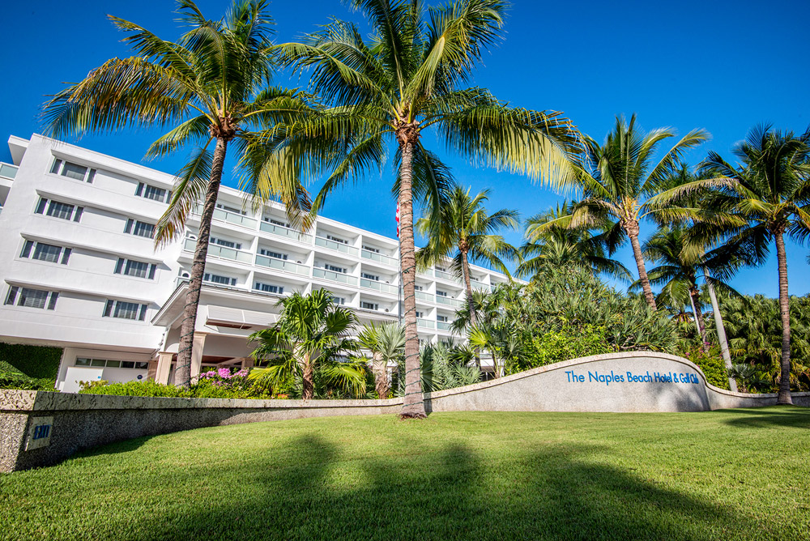
CQR Workshop 2017
Naples Beach Hotel and Golf Club
May 16-18 Naples, FL
General Program Co-Chairs:
Jason Boswell, Ericsson and Peter Thermos, Palindrome Technical Program Co-Chairs:
Hede Nakazato, Waseda Univ. and Kai Zeng, George Mason Univ

Slide 16
CQR 2017 Best Paper Awards
Best Paper Awards
Yusaka Hayamizu, Kansai University,
“Effective New Cache Decision Policy for Breadcrumbs in Content Centric Networking”
AND
Nobuhiko Itoh, NEC Corporation,
“Novel Packet Switching for Supporting Various real-time IoT Applications in LTE Networks”

Slide 17
CQR Chairman’s Awards
Established in 2004
Criteria upon which recipients were selected
sustained contributions in the field of Quality, Reliability & Security of communications services, networks or systems;
a demonstration of the core value of a professional society-adding value to others; and
integrity consistent with that of a role model
Number of recipients 2004-2017
2004 | 2005 | 2006 | 2007 | 2008 | 2009 | 2010 | 2011 | 2012 | 2013 | 2014 | 2015 | 2016 | 2017
5 | 5 | 3 | 4 | 2 | 3 | 3 | 0 | 1 | 2 | 4 | 4 | 5 | 5

Slide 18
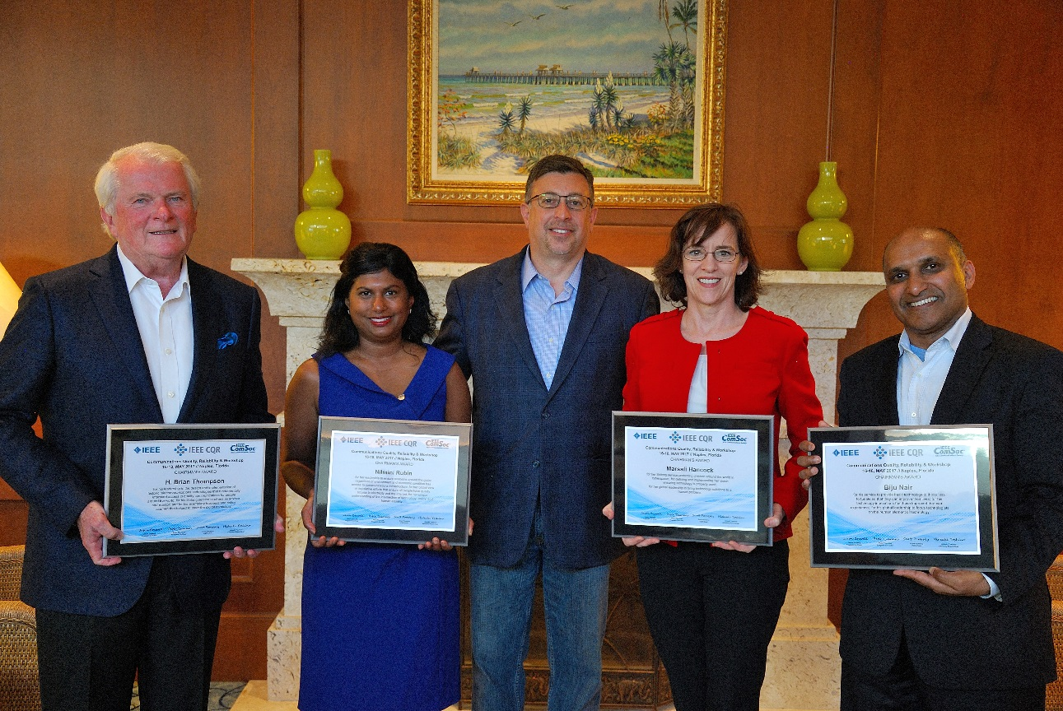
CQR 2017 Chairman’s Awards
Chairman’s Awards
Left to Right
H. Brian Thompson, GIIC
Nilmini Rubin, TetraTech
Scott Poretsky (CQR Chair and Award Presenter)
Marsali Hancock, DQ Institute
Biju Nair, Hyla Mobile
Paul Twomey, CyberGreen (Not Pictured)

Slide 19
CQR 2017 Chairman’s Awards Recipients
Nilmini Rubin (https://www.weforum.org/agenda/authors/nilmini-rubin)
“For her leadership to ensure everyone around the globe regardless of environment and economic condition has access to communications infrastructure; for her global view in legislative efforts that ensure all people have quality access to electricity and the internet; for her unique understanding of the intersection of technology, policy, and human equality.”
Marsali Hancock (Mhancock@GIIC.org)
“For her lifelong service protecting children around the world in cyberspace; for defining and implementing her vision ensuring technology is properly used; for her global leadership to bring technology solutions to a human problem.”
Biju Nair (bnair@hylamobile.com)
“For his service to provide basic technology to those less fortunate so that they can improve their lives; for his technology innovations that have improved the user experience; for his global leadership to focus technologists on the human element of technology.”
H. Brian Thompson (http://giic.org/commissioners/h-brian-thompson/)
"For his leadership designing and implementing historic telecommunications technologies that fundamentally improved access to quality communications for people around the world; for his lifelong service to others as advisor and mentor; and for his exemplary business and policy acumen that helped to steer the digital revolution."
Paul Twomey (http://www.cybergreen.net/who-we-are/)
"For his achievement in providing a steady hand in leading the development and growth of the Internet at a critical stage in history; for welcoming over one hundred nation-states to the process of shaping the Internet's future; and for his dedication to collaborating with peers to mutually solve past, present and future challenges of society as it deals with information."

Slide 20
CQR 2017 Lifetime Service Awards
Karl Rauscher
Kevin Krantz
Richard Krock

Slide 21
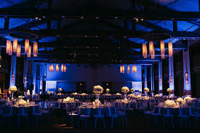
CQR Workshop 2018
AT&T Conference Center
May 15-17 Austin, TX
ICC 2018
Kansas City, KS
May 19-25

Slide 22
Convenient to Get From CQR to ICC

Slide 23
CQR Workshop 2018 Steering Committee
• General Program Co-Chairs:
Jason Boswell, Ericsson
Peter Thermos, Palindrome
Technical Program Co-Chairs:
Hede Nakazato, Waseda Univ.
Kai Zeng, George Mason Univ.
Segment and Panel Chairs:
Need topics and volunteers
Segment Chair 1: Aeneas Dodd-Noble

Slide 24
CQR Major Initiatives
Identify and promote CQR members to IEEE Senior Member status
Identify a nominee from CQR to be IEEE Distinguished Speaker
Identify new topic and lead an Emerging Technologies Roundtable
Lead CQRM at ICC 2017
Identify CQRM leaders for ICC and GlobeComm 2018
Complete 2017 Elections
Enhance website to be a unified resource for CQR-TC and the CQR Workshop
Expand use of LinkedIn
Plan CQR Workshop 2018

Slide 25
Reminder before Adjourn
Put CQR Workshop 2018 on your calendar :
May 15-17, 2018

Slide 26
Any other business?
Q&A
Communications
Quality and Reliability

